Slide 1


Data Preparation Techniques for Churn Prediction
Effective data preparation is foundational to building reliable predictive models. Key steps included converting TotalCharges to numeric and addressing missing values with the median to safeguard data quality. Removing irrelevant features like customerID streamlined the dataset, enhancing model focus.
Encoding categorical variables was carefully handled: binary categories were mapped to 0/1, while multi-class features underwent one-hot encoding to preserve information without introducing bias. Numerical features were scaled using Min-Max Scaling to ensure comparability, and duplicates were removed to maintain data integrity.

Slide 2
Exploratory Data Analysis: Distribution and Relationships
Univariate Analysis
Multivariate Trends
Histograms show that MonthlyCharges have a uniform distribution, reflecting fixed pricing plans, while TotalCharges exhibits right skew due to customer tenure variation. Box plots pinpoint outliers in charges that may represent unusual customer cases.
Box and violin plots indicate churned customers usually have higher monthly charges, shorter tenure, and lower total charges. These trends signal pricing and engagement as churn factors.
TotalCharges increasing linearly with tenure validates data consistency and customer billing patterns.
Count plots reveal a class imbalance in churn, crucial for model adjustment strategies.

Slide 3
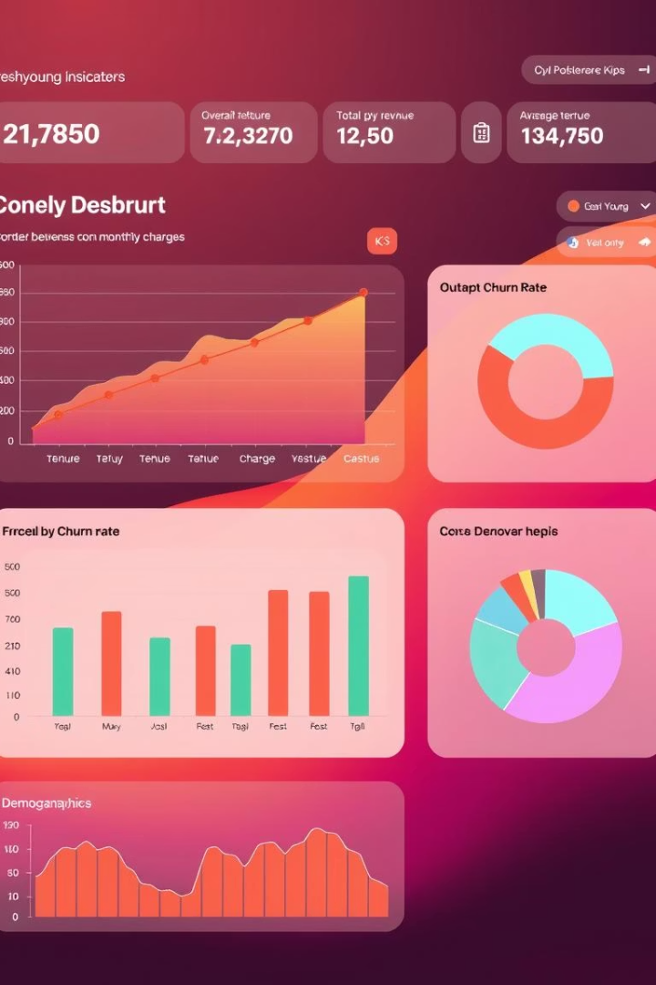
Data Visualization Insights Driving Business Decisions
Monthly Charges
Total Charges and Tenure
Higher charges strongly correlate with churn, suggesting pricing plans may influence customer retention strategies.
Lower total charges in churned customers imply early contract termination; strong tenure correlation reaffirms customer lifetime value focus.
Effective Visualizations
A mix of count plots, scatterplots, and heatmaps highlight key patterns and support actionable insights for targeting churn reduction.

Slide 4

Statistical Analysis for Understanding Variable Relationships
Robust statistical tests such as T-tests, ANOVA, and Chi-square were employed to validate relationships between variables. These tests allow precise determination of whether observed differences are statistically significant.
Interpreting p-values ensures the results are not due to random chance, strengthening confidence in key predictors and supporting model feature choices.
This analytical rigor underpins trustworthy conclusions about data attributes driving churn behavior.

Slide 5

Strategic Feature Selection with Recursive Elimination
Recursive Feature Elimination (RFE) paired with Logistic Regression systematically identifies the most impactful features on churn prediction. This approach iteratively removes less important variables, refining the feature set.
Ranking features by importance helps prioritize efforts for model building, resource allocation, and interpretability, ensuring the inclusion of relevant predictors while excluding noise.
Utilizing this method enhances model efficiency and performance by focusing on key drivers.

Slide 6
Enhancing Models through Feature Engineering
New Feature Creation
Normalization and Encoding
Introducing derived features—such as tenure_group, engagement score, and service counts—provides richer customer behavior representation than raw data alone.
Z-score standardization normalizes numeric features, while one-hot encoding and frequency encoding manage categorical variables effectively, improving model handling of diverse data types.
The nuanced features better capture dynamics impacting churn and enhance predictive power.

Slide 7
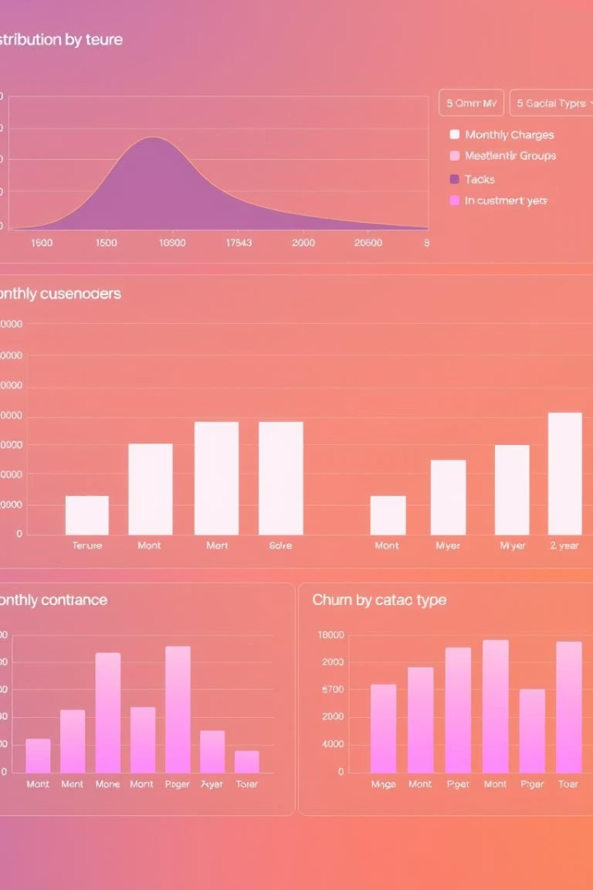
Visualizing Churn Distributions and Influencing Factors
Tenure
Overall Churn
Distribution charts clarify how customer tenure relates to likelihood of churn, identifying risk periods.
Highlighting class imbalance helps plan strategies for model training or marketing interventions.
Pricing and Contract Impact
Box plots and stacked bar charts reveal how monthly charges and contract types are associated with churn behavior.

Slide 8
Robust Machine Learning Pipeline Setup
Data Preparation
Model Tuning and Evaluation
Splitting data into features and target, followed by train-test division with 20% reserved for testing, preserves model generalizability.
Grid Search coupled with cross-validation identifies optimal hyperparameters for Logistic Regression and Random Forest models.
Standard scaling on numeric features aids convergence across models.
Evaluation metrics assessed include accuracy, precision, recall, F1 score, ROC AUC, and confusion matrix for comprehensive performance insights.

Slide 9
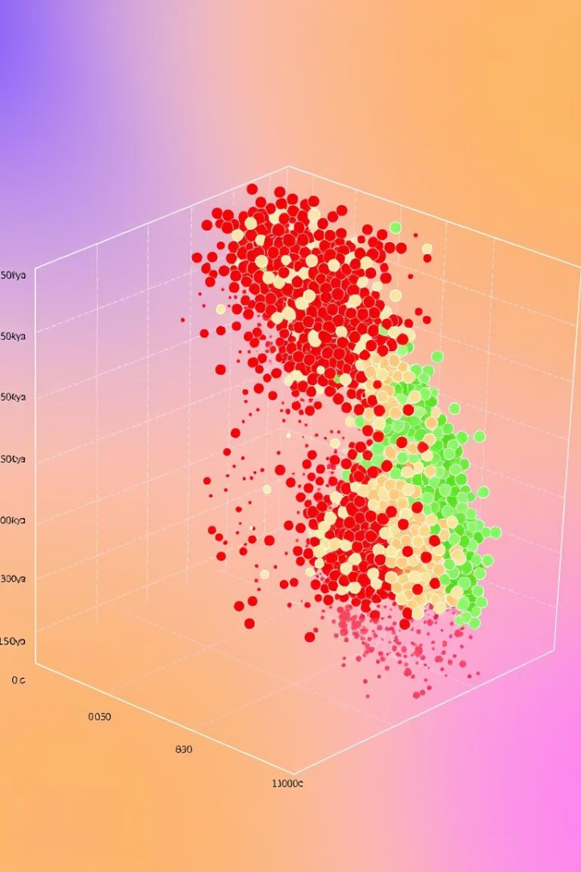
Dimensionality Reduction with PCA for Visualization
Principal Component Analysis (PCA) reduces the feature space to two dimensions, enabling visual exploration of customer grouping and churn distribution.
This technique helps reveal natural clusters, overlaps, and decision boundaries that inform model interpretability and further feature engineering.
Dimensionality reduction is a critical step for both visualization and simplifying complex high-dimensional datasets.

Slide 10
Interactive Streamlit Dashboard for Churn Prediction
Dynamic CSV Upload
Customizable Model Pipeline
Users can interactively upload their dataset to run predictions, tailoring the analysis to their data context without coding.
Options to select target variables and features empower data scientists to experiment efficiently within a streamlined workflow.
Real-time model evaluation feedback supports iterative refinement and informed decision-making based on metrics.

Slide 11

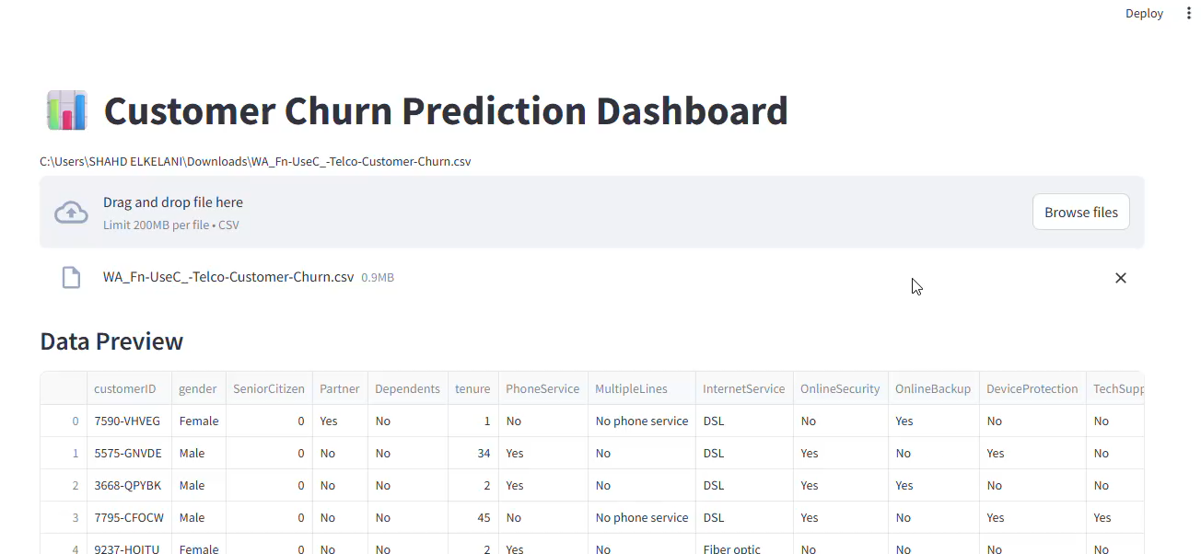
Interactive Streamlit Dashboard for Churn Prediction
Our dashboard lets users upload CSV files to analyze their own data instantly.
Customizable model selection and real-time feedback drive dynamic insights.
This tool empowers quick experimentation and informed decision-making for data teams.

